Slide 1
Solar makes sense for Africa !!
Group: Cool
Target Audience: Committee on Transport, industry, Communications, Energy, Science of the African Union.

Slide 2
Data Provenance and Usage
US Energy Information Administration
Plotted world energy production and consumption
Analysed energy data by world region
Analysed energy data by world economic region (developed, developing and transition economies)
The World Energy Council
Plotted world installed solar capacity

Slide 3
Data Provenance and Usage
Questions we sought to explore:
Energy Consumption/Production trend by world region

Slide 4
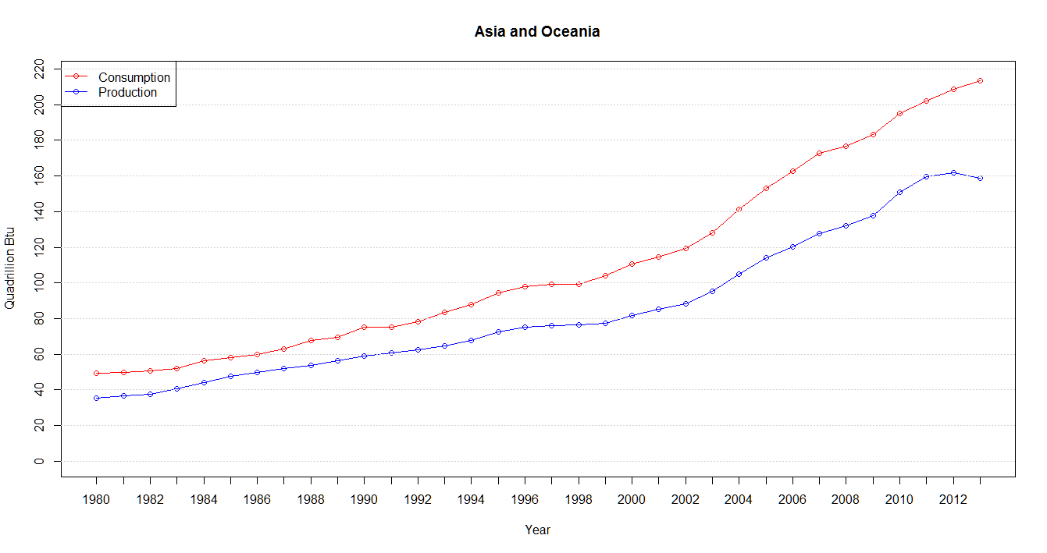
Trend by region

Slide 5
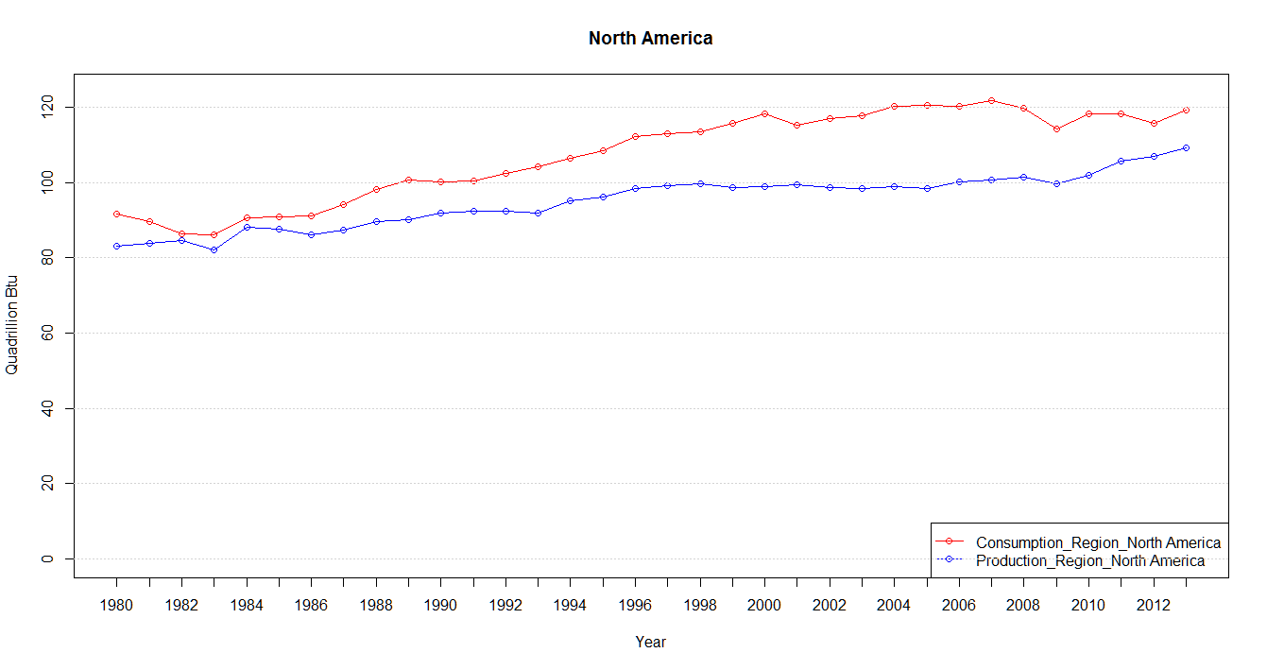
Trend by region

Slide 6
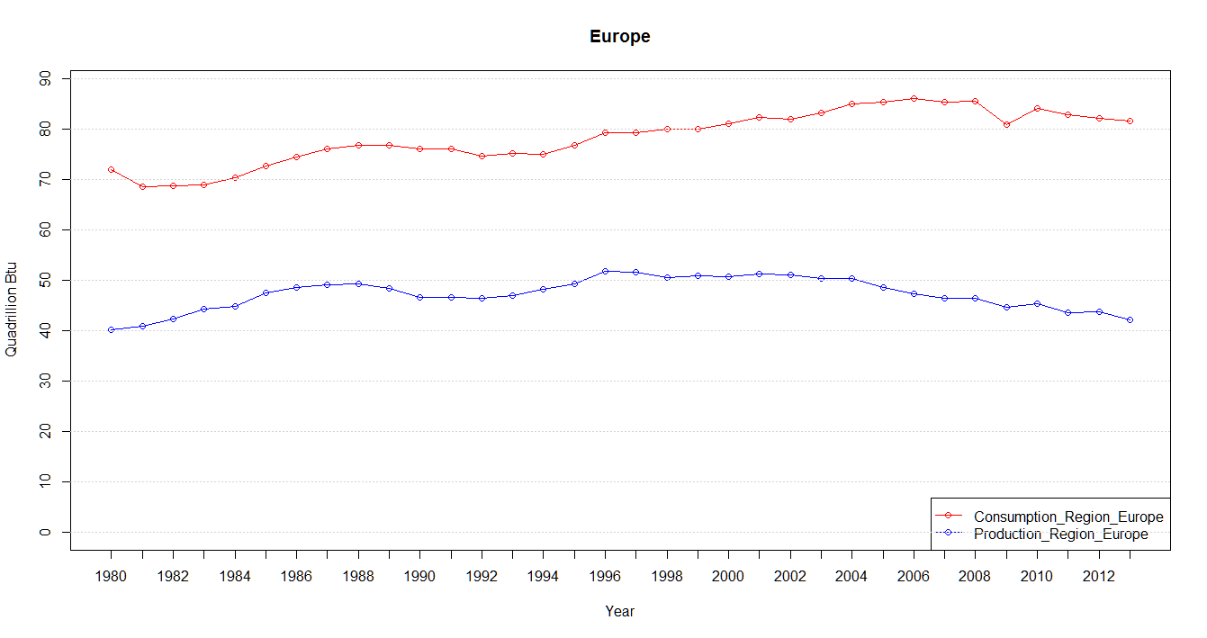
Trend by region

Slide 7
Data Provenance and Usage
Questions we sought to explore:
Energy Consumption/Production trend by economies (Countries were grouped into 3 categories: developed, transition and developing economies)

Slide 8
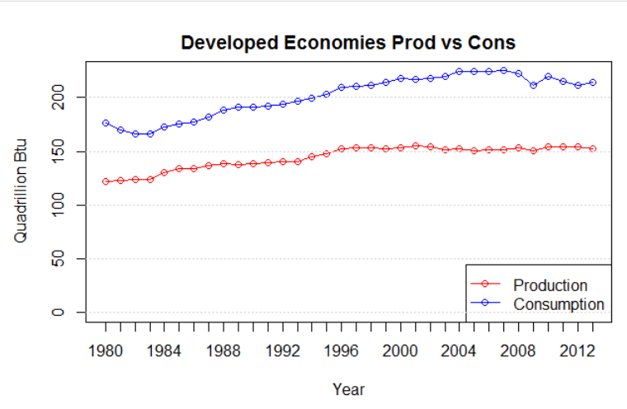
Trend by economies

Slide 9
Data Provenance and Usage
Questions we sought to explore:
Energy Consumption/Production through major events: wars

Slide 10
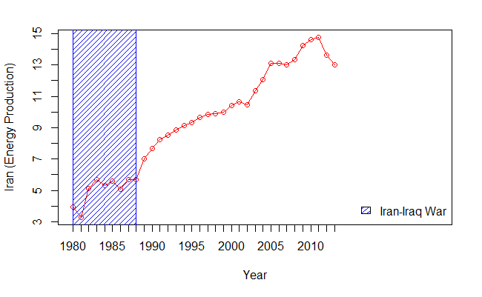
Trend with wars

Slide 11
Data Interpretation/ Findings
Energy use is going up world wide. Trend likely to continue!
Smaller Wars did not have major impact on energy data. But large scale wars like Iran/Iraq war in 1980s disrupted energy consumption and production. This is clear from our graphs.
Developed countries use more energy than they can produce
Most of the energy consumed are obtained from fossil fuels

Slide 12
Why this is important
Who should care
Current energy use is affecting the climate irreversibly.
Climate change will affect the developing nations the most. They are the most vulnerable to droughts, floods, mass migrations etc.
All of us should care.
Most energy sources today are non-renewable and are expected to run out in the next 50-100 years.
Energy policy makers should act accordingly.

Slide 13
What about Renewables?
Now is the time to invest in renewable
Most developed countries are still debating whether to act or not
Developing countries could become pioneers
Build energy sustainable economies sooner than later
Case for African continent - Invest in solar!

Slide 14
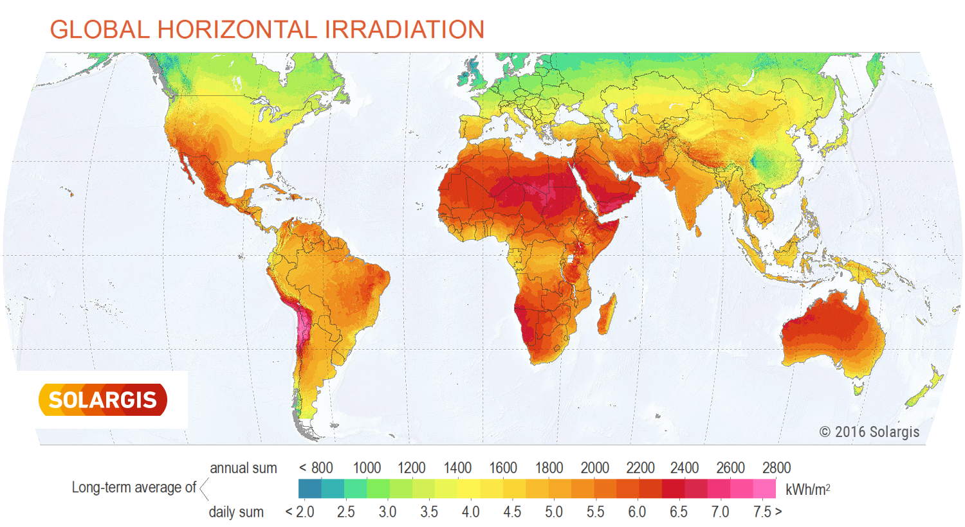
AU, Solar makes sense for you !

Slide 15
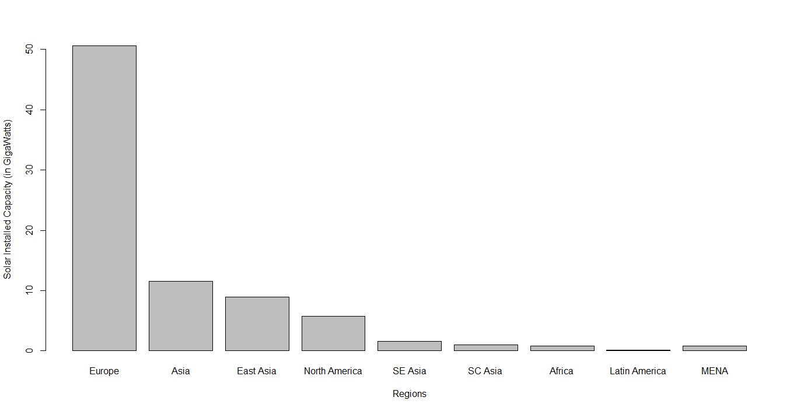
Solar installed capacity by region
Solar graph/plot

Slide 16
AU, Solar makes sense for you !
European, Asian and American colleagues
Can’t seem to agree on the right policies.
Taking actions too late
Many climate treaties but no concrete enforcement (Kyoto, Paris)
African Union
Chance to get ahead of the game
Africa and Australia receive more solar coverage than any other in the world
The sun is free and abundantly available especially in Africa
Many initiatives already: Morocco, South Africa, Ghana

Slide 17
AU, Solar makes sense for you !
Renewable is way to go. Nothing more renewable than the sun.
can contribute to reduced dependence on energy imports
No fuels price or constraints
Improves security of supply
enhances energy diversity and hedges against price volatility of fossil fuels, thus stabilising costs of electricity generation in the long term
no greenhouse gas (GHG) emissions during operation
Does not emit other pollutants (such as oxides of sulphur and nitrogen)

Slide 18
Questions ?

